Slide 1
TShark and Digital Forensics
Packet stats, filtering, and search

Slide 2
Tshark Introduction

Slide 3
Overview
Packet capture: -w
Packet stats: -z -r
Filtering packets: -Y protocol.field contains/matches
Show the content of packets: -V, -x
Globe search: grep
Show protocol header field value: -T fields –e field

Slide 4
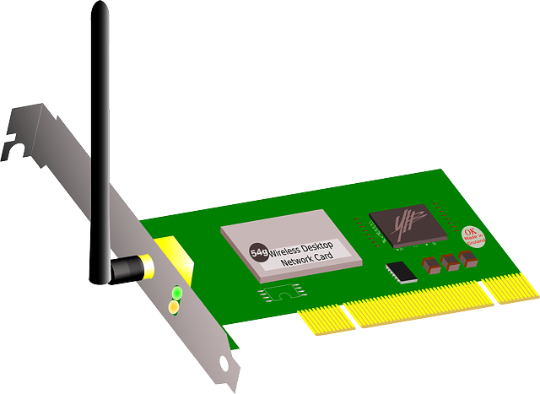


What is TShark
Wireshark (GUI)
tshark (CLI)
Terminal-based Wireshark
Supports the same options as Wireshark
Uses libpcap as its packet capture library
libpcap is a portable C/C++ library for network packet capture
used for packet sniffing, network monitoring, and network security.
provides an interface for capturing packets from network devices
supported by a wide range of operating systems, including Linux, Windows, and macOS.
Notes:
https://www.wireshark.org/docs/wsug_html_chunked/AppToolstshark.html

Slide 5
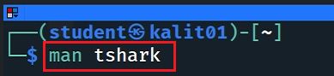
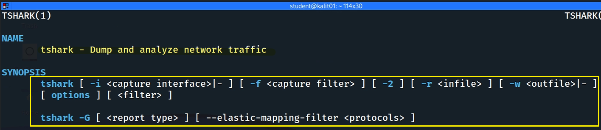
Notes:
https://www.wireshark.org/docs/wsug_html_chunked/AppToolstshark.html

Slide 6
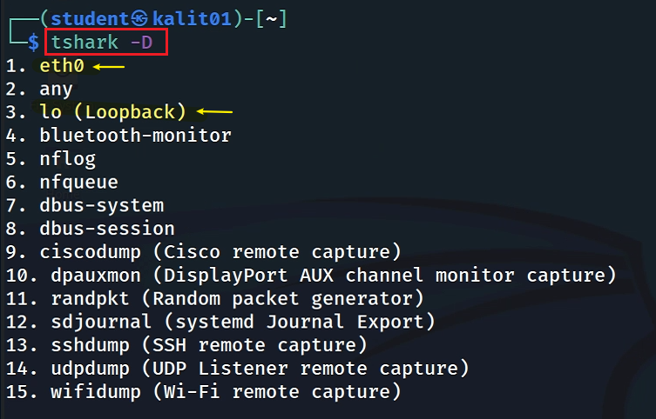
Showing computer’s network interfaces

Slide 7
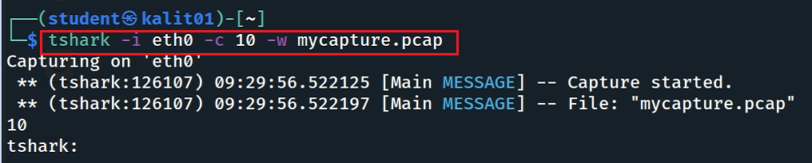
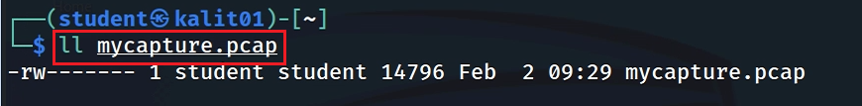
Capture traffic to a file
Capture 10 packets on interface eth0 and save them to a file

Slide 8
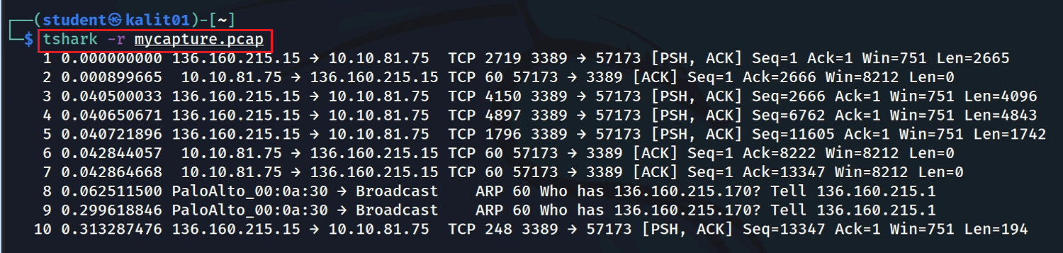
Show packets
Note: your results are different from mine
Capture 10 packets on interface eth0 and save them to a file

Slide 9
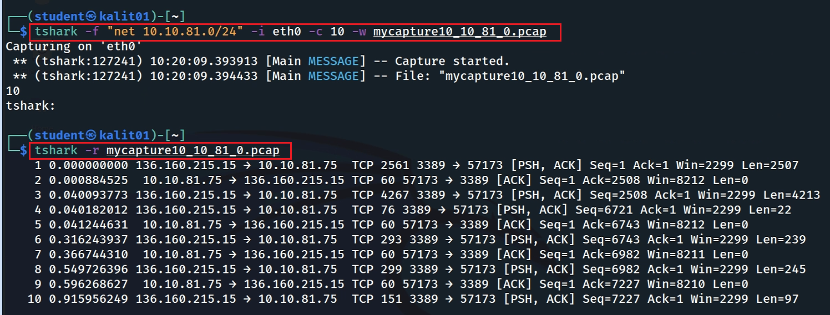
Filtering packet
Only capture the traffic of the subset 10.10.81.0
-f <capture filter> packet filter in libpcap filter syntax

Slide 10
libpcap filter syntax
protocol [expression operator value]
protocol
tcp, udp, icmp
expression: a field within the protocol header to filter on
src port, dst port, src host
operator: a comparison operator
<, >, ==, !=
value: the value to compare the expression against
tcp port 80
ip src host 192.168.1.100
tcp dst port 22

Slide 11
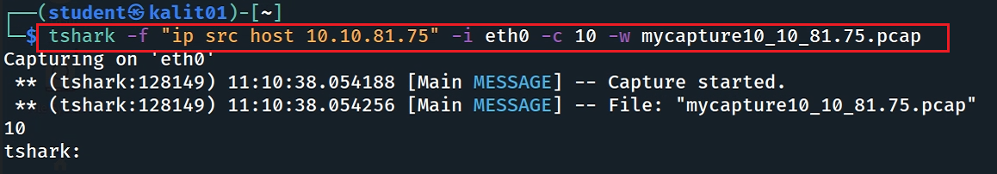
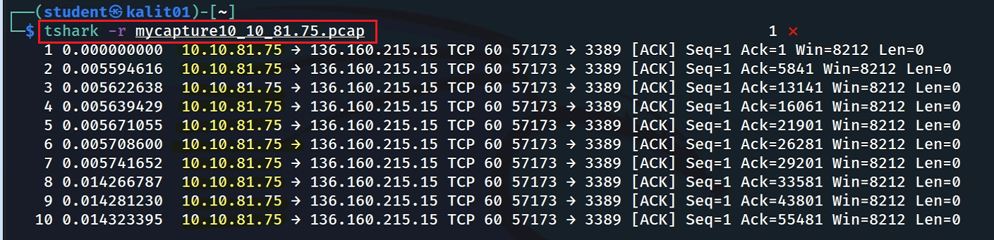
Apply filter with ip source address

Slide 12
Packets Stats

Slide 13

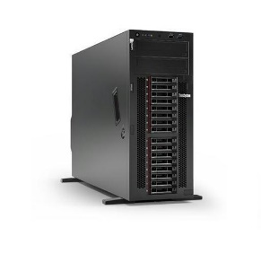
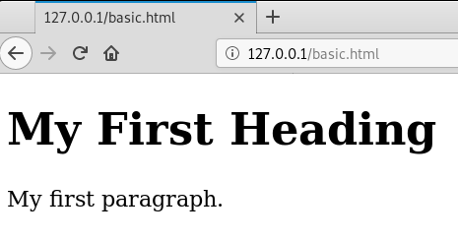
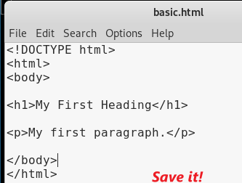
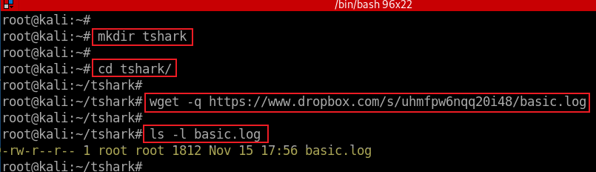
Port 52054
Port 80
HTTP Request
HTTP Response
Generated using curl
Notes:
wget -q https://www.dropbox.com/s/uhmfpw6nqq20i48/basic.log

Slide 14
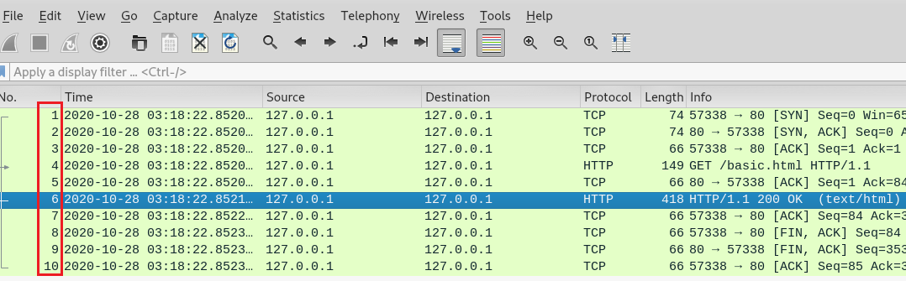

Slide 15
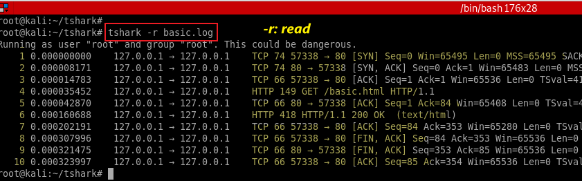
# if tshark is not install
sudo apt install tshark
Show all packets
# remove annoying “… This could not dangerous” message
tshark -r basic.log 2>/dev/null
Notes:
sudo apt install tshark
https://www.wireshark.org/docs/man-pages/tshark.html

Slide 16
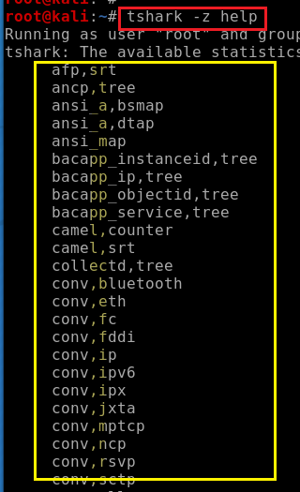
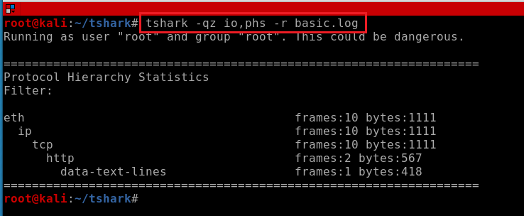
Identify the protocols (hierarchy statistics) that are used most frequently in network traffic
Show all stats parameters
1 frame with data-text-line with a length of 418
2 frames with HTTP have a total length of 517
10 frames with tcp have a total length of 1111
-q: run in "quiet" mode, which suppresses the display of the captured summary information
-z <statistics>: collect various types of statistics and display the result after finishing reading the capture file.
io,phs display IO and protocol hierarchy statistics.
io shows the statistics of input/output operations
phs shows the statistics of the protocols

Slide 17
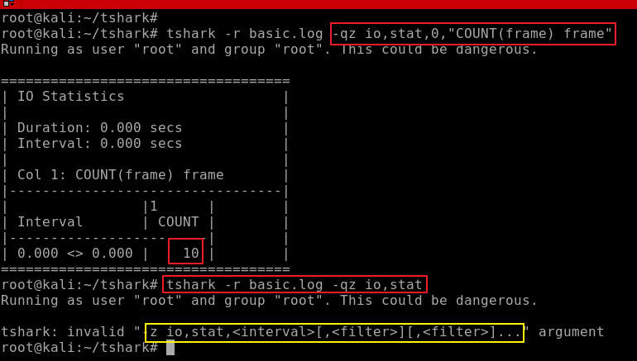
no space
Count the numbers of packets
-q: quit (don’t show packets)
-z: statistics, io,stat is one of stats
0: over all packets, otherwise is interval seconds
[COUNT|SUM|MIN|MAX|AVG](<field>)<filter>
Notes:
tshark -r basic.log -qz io,stat,0,"COUNT(frame) frame"

Slide 18
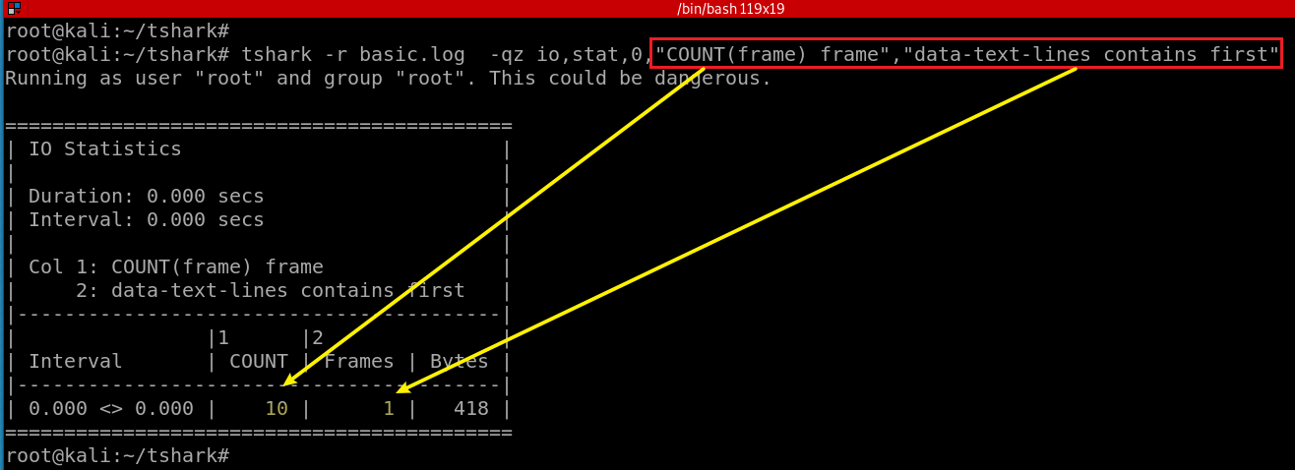
no space
Count the numbers of packets that contain the key word “first”

Slide 19
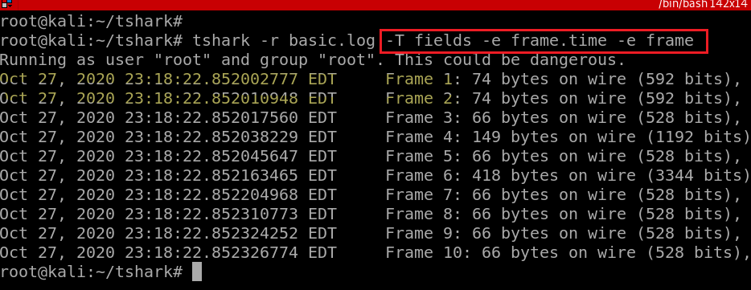
-T pdml|ps|psml|json|jsonraw|ek|tabs|text|fields|? format of text output (def: text)
-e <field> field to print if –T fields selected (e.g., tcp.port, ws.col.Info)
Show all packets with readable time

Slide 20
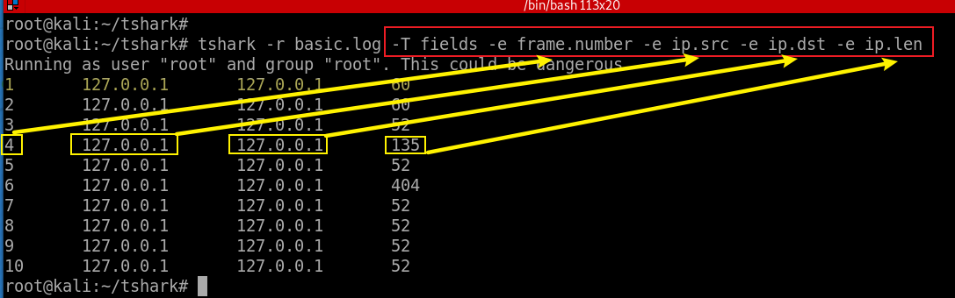
-Y <display filter>
Show fields of packets
-T : set the format of the output
-e: add a field to the list of fields
Notes:
https://tshark.dev/analyze/packet_hunting/packet_hunting/
http://yenolam.com/writings/tshark.pdf

Slide 21
Packets Filtering using Yank Filters

Slide 22
Yank filters: -Y option With field properties
The syntax of Yank filters in Wireshark and tshark is the same as the syntax for Wireshark display filters.
Display filters in Wireshark use a simple, straightforward syntax for selecting the packets to display based on the values of fields within the packet headers.
protocol.field operator value
field: the name of a field within a packet header
property: the property of a field
operator: a comparison operator
==, <, >, !=, etc.
value: the value to compare the field against.

Slide 23
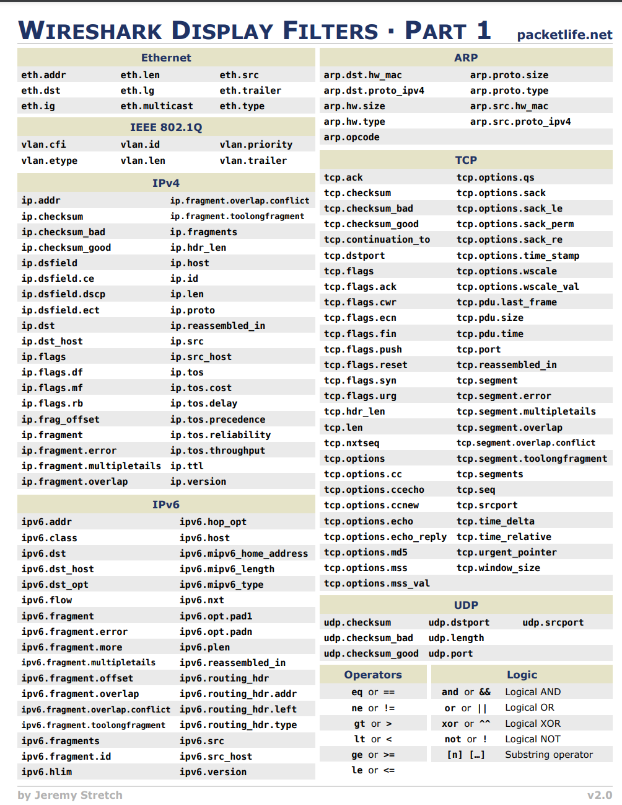
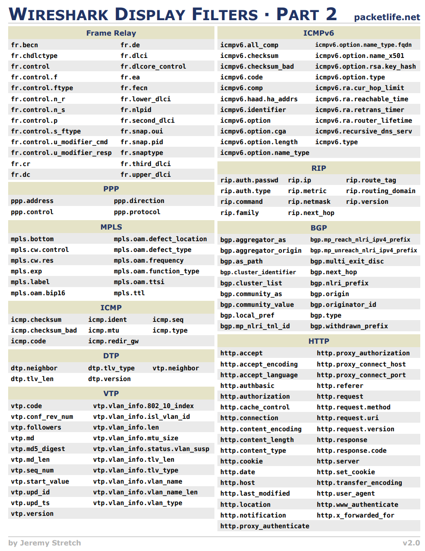
Notes:
https://packetlife.net/media/library/13/Wireshark_Display_Filters.pdf

Slide 24
Protocol header and fields
direction | eth | ip | tcp | udp
source | src | src | srcport | srcport
destination | dst | dst | dstport | dstport
either | addr | addr | port | port
eth.src == 00:11:22:33:44:55: Source MAC address is 00:11:22:33:44:55
ip.addr == 1.2.3.4: Find all traffic that has IP of 1.2.3.4
tcp.dstport != 21: Destination of tcp port is NOT 21

Slide 25
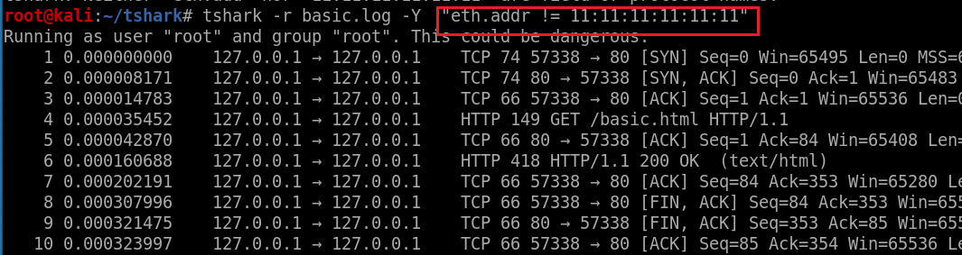
Find a specific packet with a mac address not equal to “11:11:11:11:11:11”
# return the same same results
tshark -r basic.log -Y "eth.addr contains 00"
Notes:
tshark -r basic.log -Y "eth.addr != 11:11:11:11:11:11"

Slide 26
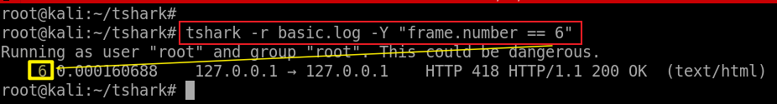
frame: field name
frame.number: a filed property
Find a specific packet with a frame number
-Y: display filter
Find a specific packet with “data-text-lines (e.g., http response with content/200 OK)”
Notes:
tshark -r basic.log -Y "frame.number == 6"

Slide 27
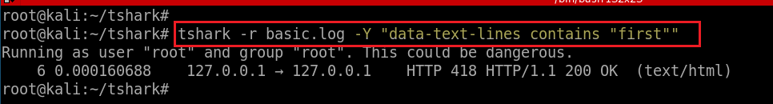
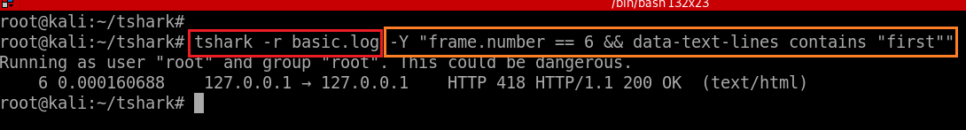
Find frame numbers if packets have HTTP content
Find frame numbers with both conditions
Notes:
tshark -r basic.log -Y "data-text-lines contains "first""

Slide 28
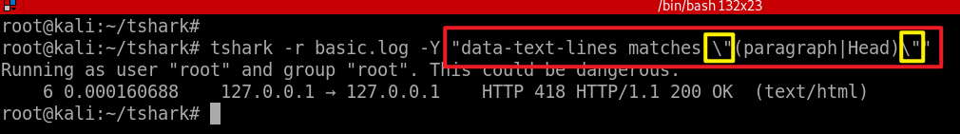
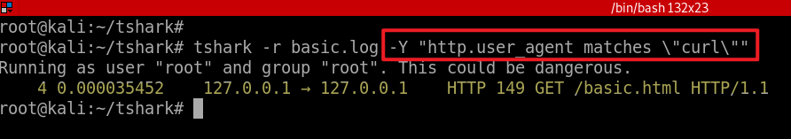
Find frame numbers with both matches Perl-compatible regular expression
contains Does the protocol, field or slice contain a value
matches, ~ Does the protocol or text string match the given
case-insensitive Perl-compatible regular expression
https://perldoc.perl.org/perlre
(paragraph|Head): keywords “paragraph” or “head”
-Y “ matches \“ \” ”
Find frame numbers with the user agent matches “curl”
Notes:
tshark -r basic.log -Y "data-text-lines matches \"(paragraph|Head)\""

Slide 29
-Y "eth.addr contains 00:11:22"
-Y "eth.addr[0:3] == 00:11:22"
-Y "eth.addr matches \“^[^\x01-\xff]\x11\x22\""

Slide 30
Show and Search Packet Content

Slide 31
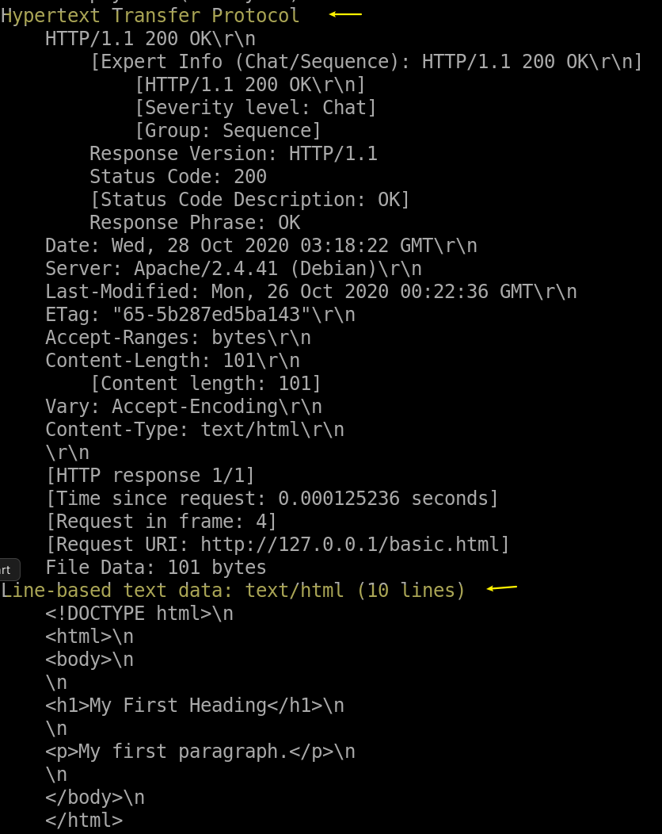
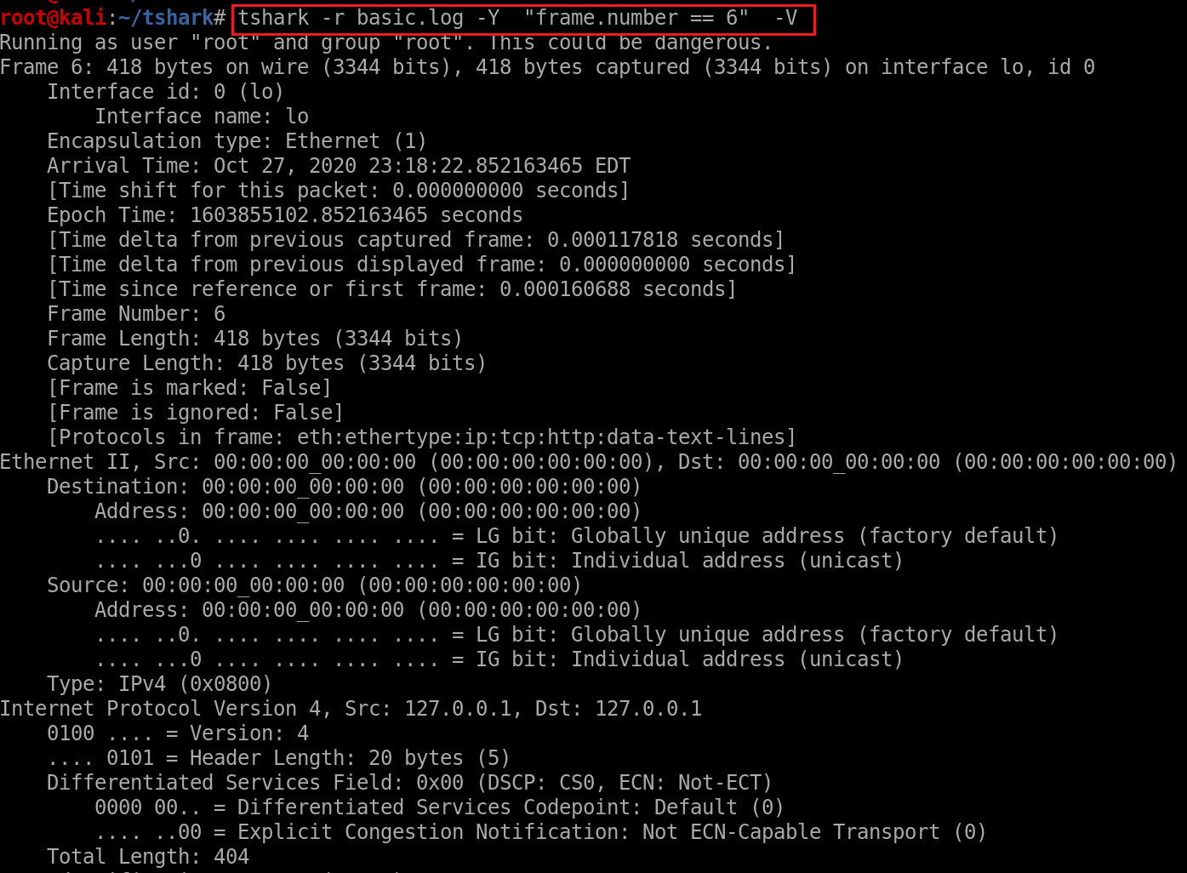
Show packet details -V

Slide 32
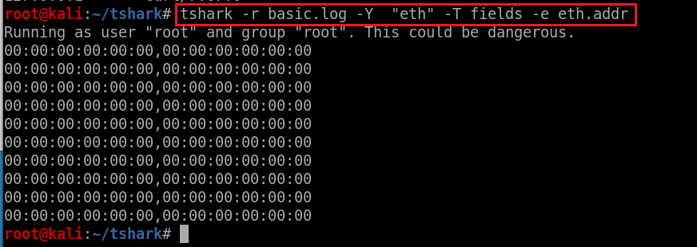
-Y protocol –T fields –e protocol.field
Find all mac addresses

Slide 33
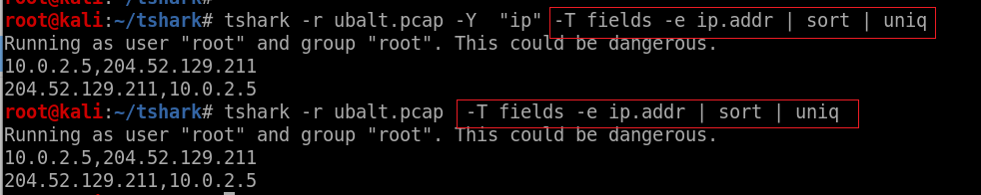
The filtering means “has ip”
Find all ip addresses

Slide 34
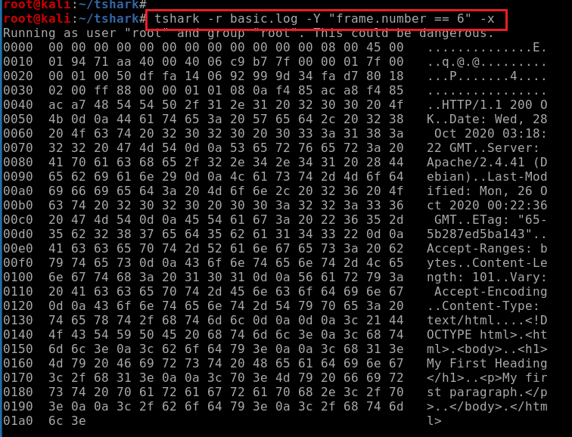
Output of hex and ASCII dump of packet -x
-x: hex/ASCII
-V: readable interptation
Output of text of packet

Slide 35
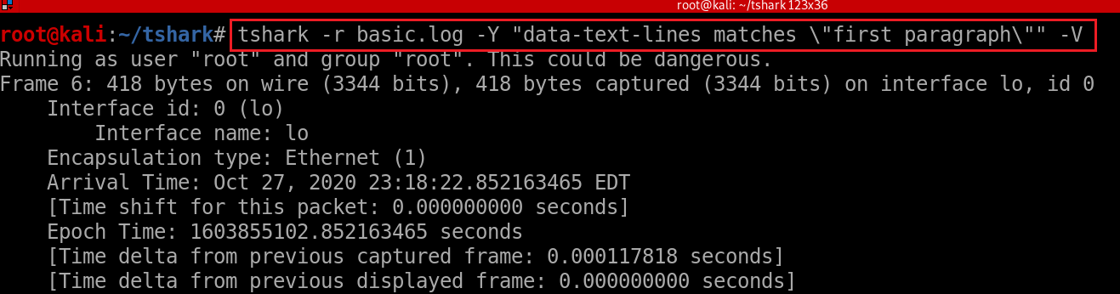
Filtering with keywords and showing content -V
Filtering and search keywords

Slide 36
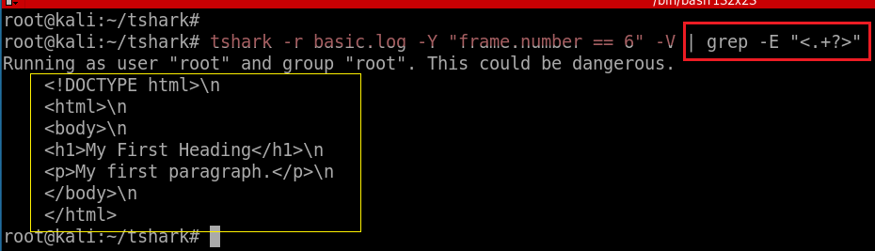
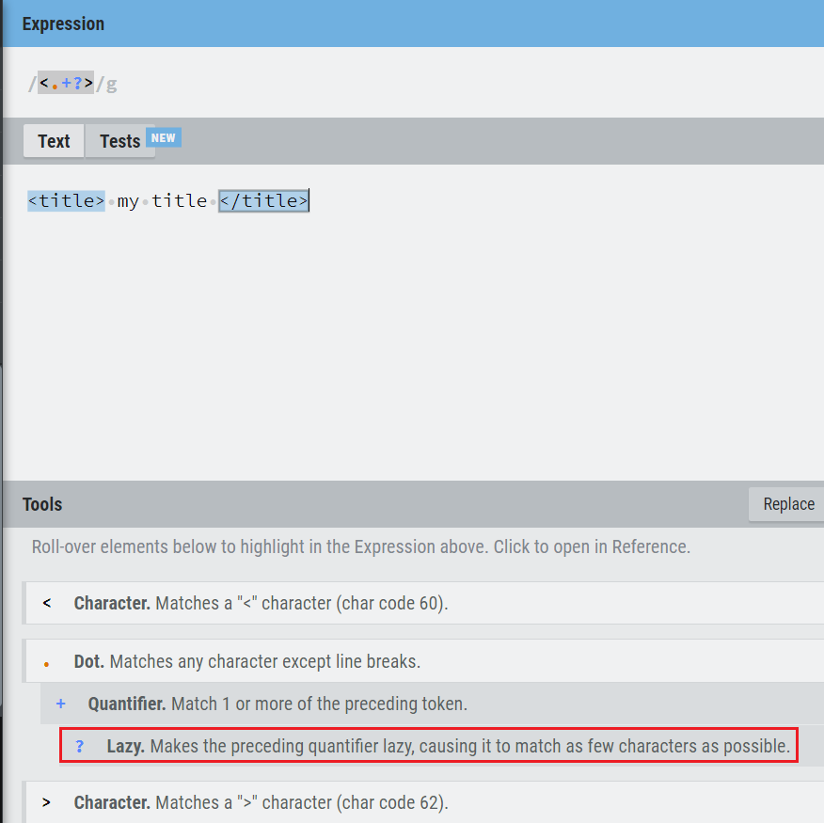
Find lines in packets contain HTML
https://regexr.com/

Slide 37
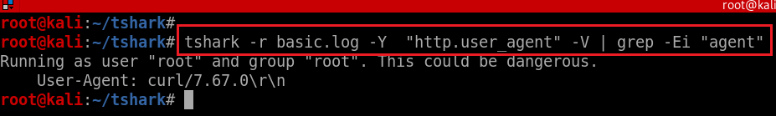
Find user-Agent

Slide 38
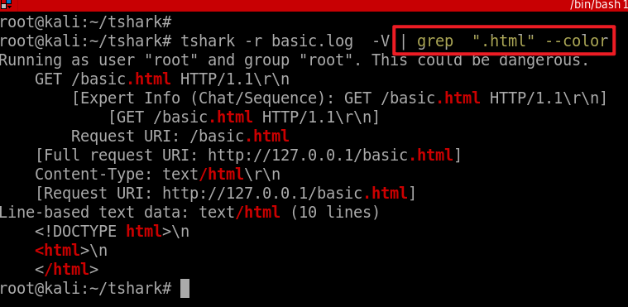
Match any lines contains the key word “.html”

Slide 39
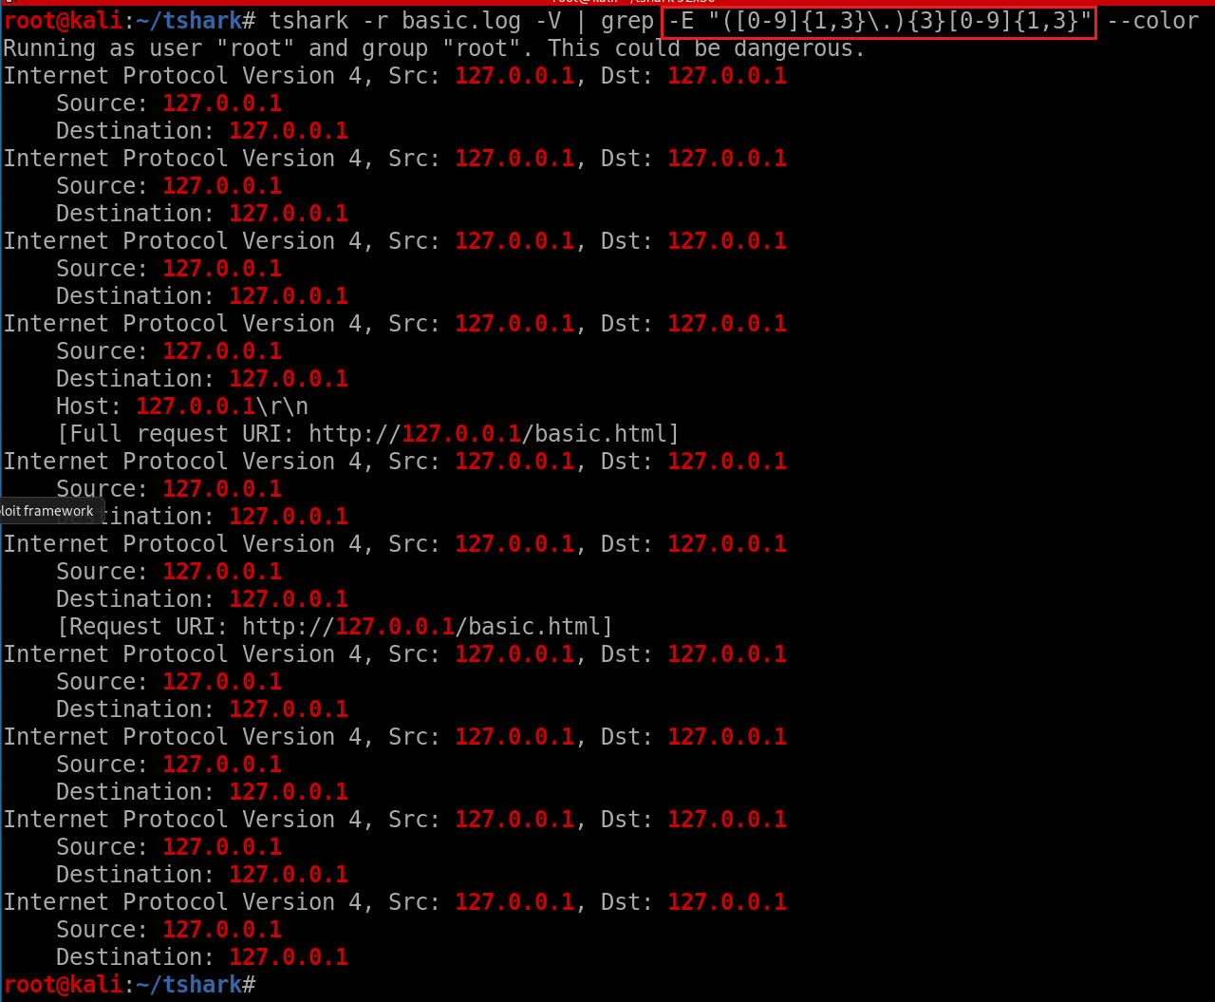
Match IP address (globe match)
-o: only show matched results

Slide 40
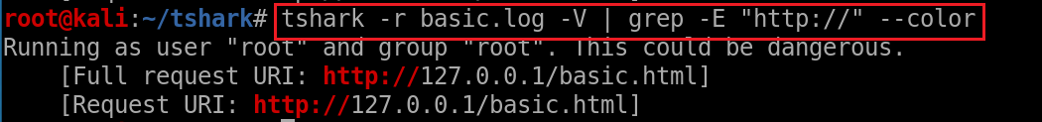
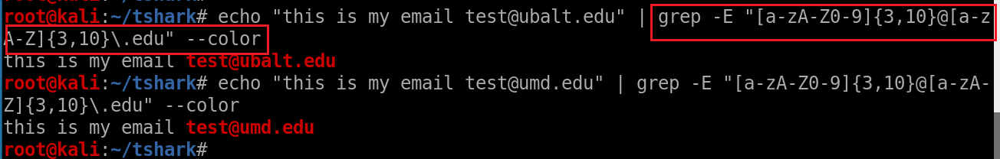


Search http
Search email addresses
show [a-zA-Z0-9] is equivalent to \w
Notes:
echo "this is my email test@ubalt.edu" | grep -E "[a-zA-Z0-9]{3,10}@[a-zA-Z]{3,10}\.edu" --color

Slide 41
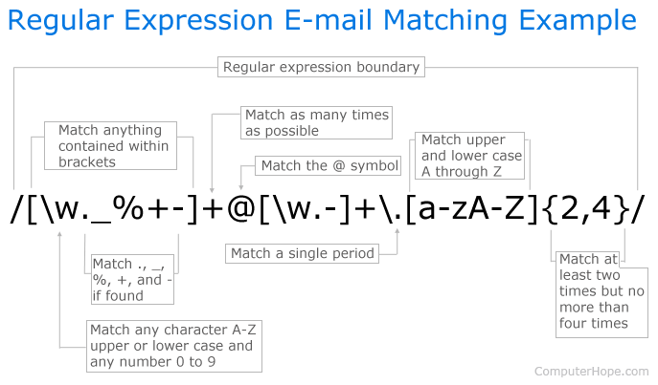
Notes:
https://www.computerhope.com/unix/regex-quickref.htm
\b[\w._%+-]+@[\w.-]+\.[a-zA-Z]{2,4}\b

Slide 42
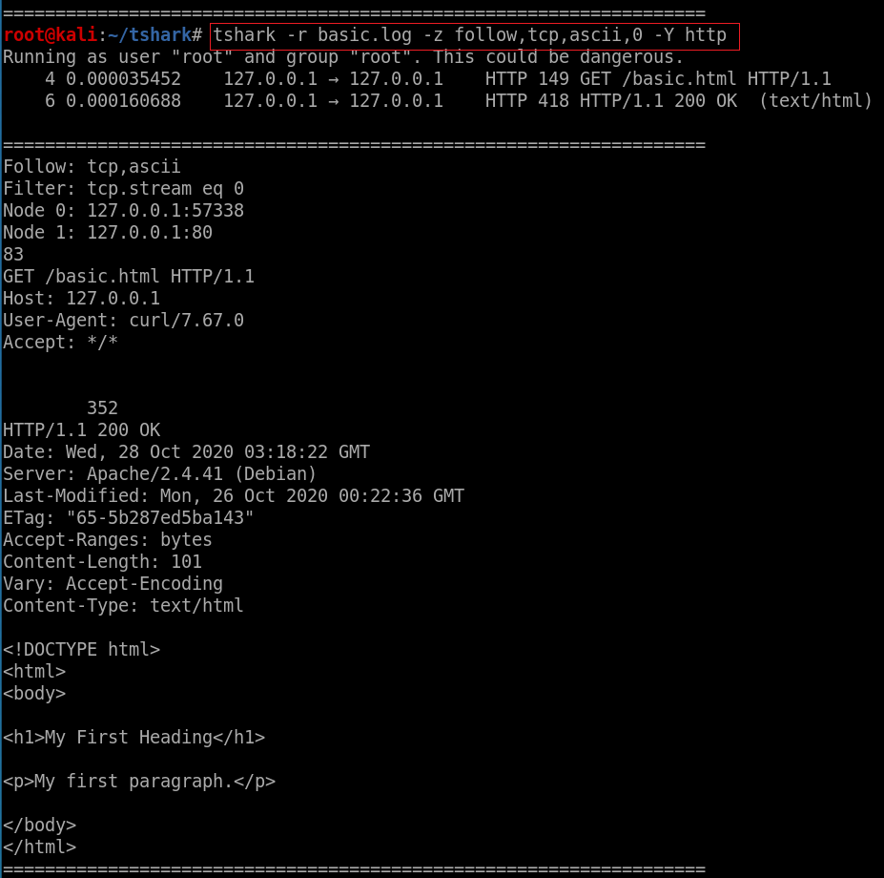
Follow TCP stream
-r : specifies the input file.
-z follow,tcp,ascii,0 enables the "follow TCP stream" feature and sets the output to ASCII and stream number 0.
-Y http is a display filter that only shows the HTTP packets in the capture file.
The "follow TCP stream" feature will display the HTTP data transmitted in the specified stream (stream number 0 in this case), making it easier to inspect and analyze the HTTP traffic.
Notes:
tshark -r basic.log -z follow,tcp,ascii,0 -Y http

Slide 43
How to find protocols and field names?

Slide 44
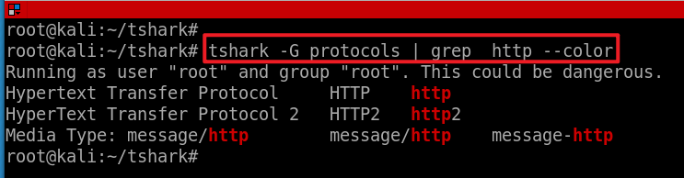
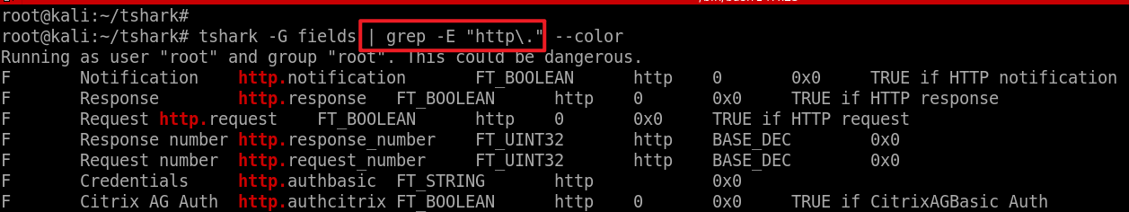
HTTP and fields
Find HTTP protocol name
Find HTTP field names
Note: \. matches . Literal, otherwise matches any one character
-G fields: dump field name
-E: pattern match
--color: highlights

Slide 45
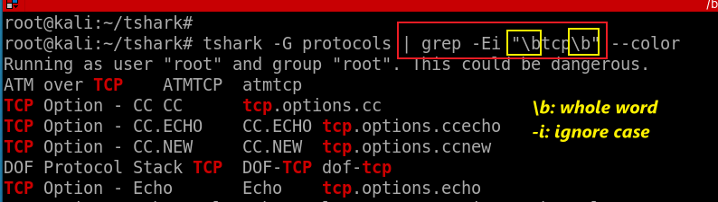
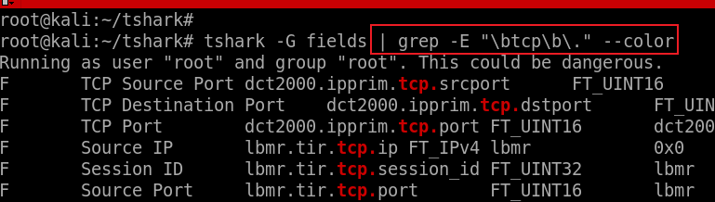
TCP and field names
Find TCP protocol name (the whole word ) => tcp
Find field names that are associated with tcp

Slide 46
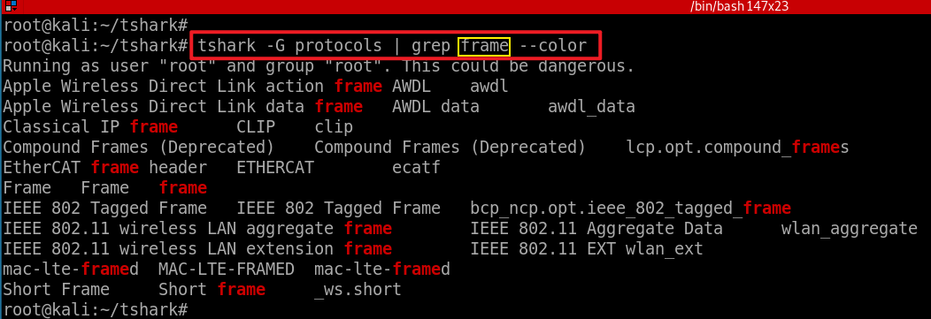

Frame and field names
Find protocol names contain frame
Find field names contains frame
Notes:
tshark -G fields | grep -E "frame.number" --color

Slide 47

Find details of frame.time

Slide 48

Metacharacter Sequence | Meaning | Example Expression | Example Match
^ | Start of string or line | ^abc | abc (appearing at start of string or line)
() | group
(?=) | look ahead | foobarbarfoo bar(?=bar) | finds the 1st bar ("bar" which has "bar" after it)
Match any two words, can be in a different order
Notes:
tshark -G fields | grep -P "^(?=.*protocol)(?=.*name)"
https://www.computerhope.com/unix/regex-quickref.htm

Slide 49



https://regex101.com/
Notes:
https://regex101.com/
^(?=.*protocol)(?=.*name)

Slide 50
Summary
Packet capture: -w
Packet stats: -z -r
Filtering packets (return packet summary info)
-Y protocol.field contains/matches
Show the content of packets
–V, -x
Globe search
grep
Search field value
-T fields –e field1, -e field2

Slide 51
Assignment

Slide 52
Tasks
Capture traffic between your machine and ubalt.edu
Count all captured packets
Show the first 10 packets
What is the frame number of HTTP response containing web content?
Which frame numbers contain phone numbers?
Show phone numbers?
What is your machine’s mac address?
What is the mac address of ubalt web server?

Slide 53

Hints
tshark -D //eth0
ping ubalt.edu //204.52.129.211
capturing with a filter

Slide 54

hints
tshark -r ubalt.pcap -Y "data-text-lines“
tshark -r ubalt.pcap -Y "frame.number == 14 && data-text-lines“
tshark -r ubalt.pcap -Y "frame.number == 14 && data-text-lines" –V
tshark -r ubalt.pcap -Y "frame.number == 14 && data-text-lines" -V | grep -E "[0-9]{3}\.[0-9]{3}\.[0-9]{4}" --color

Slide 55


Find Mac address
Notes:
tshark -r ubalt.pcap -Y "frame.number == 14 && data-text-lines" -V | grep -E "([0-9A-Fa-f]{2}[:-]){5}([0-9A-Fa-f]{2})" –color
tshark -r ubalt.pcap -Y "eth" -T fields -e eth.addr | sort | uniq

Slide 56


